Slide 1

National Defense Industrial Strategy (NDIS)
---
Initial Thoughts
Presented by the IBCWG
at
DMAG meeting 25 January 2024

Slide 2
The NDIS is for a domestic audience
A strong message that the industrial base is important and that it will require investments ($$) to maintain
The NDIS is linked back to the 2022 National Defense Strategy
The text repeats the need for “Allies and Partners” - appear 1.2 times/page
Recognition that military strength is tied to industrial strength
  Signal that industrial base capacity is a form of deterrence
Meant to guide industrial base policies, engagements, and initiatives over the next 3-5 years
  COVID, the War in Ukraine, the situation in the Indo-Pacific have shown that the industrial base lacks excess capacity and supply chains have fragilities (sole source suppliers and dependence on adversarial suppliers for things like Rare Earth Elements & Critical Minerals)
You can't see the forest for all the trees!

Slide 3
The NDIS is for a domestic audience
The NDIS focusses heavily on bolstering domestic production including:
  “expanding foreign defense company production within the United States”;
  “reducing barriers to entry for [US] small and medium-sized business”; and
  increasing Foreign Military Sales (FMS) “to achieve economies of scale by sharing some of the burden of acquisition and sustainment”. (see slide 6)

Slide 4
Challenges to overcome
Document recognizes the challenges:
  DoD is a difficult customer
  Unstable/inadequate demand signals
  Budget uncertainty
  A shortage of skilled workers
  Lack of domestic manufacturing capacity
  Not sufficiently leveraging dual-use technology
These challenges have existed for decades despite previous efforts and initiatives to overcome them.

Slide 5

NDIS opens for Allies and Partners
The door has been opened to allies and partners
  We will have to work hard to get in…
  We as allies and partners can help…
The US wants to engage allies to increase the number of Security of Supply Arrangements (SOSA)
The NDIS could be read as asking only for more domestic contest
- or -
As a way to reduce PRC influence together with the allies and partners

Slide 6

FMS
The US want visibility and understanding of ally and partner capability requirements into acquisition and contracting guidance – in part to expanding US domestic production capacity.
The nations want fast and predictable deliveries
Changes to the FMS system should be done in dialogue with the nations
DMAG should support this with a panel

Slide 7
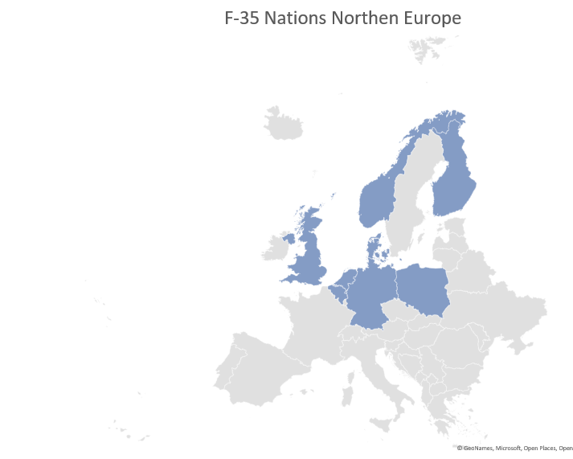
Changes to export control are key to implement the NDIS to better align with Allies and Partners
Nothing specific in the NDIS about this
The US desire to control technology need to be reviewed and focus more on coalition interoperability
Example: help and encourage the nations with the same equipment to cooperate

Slide 8
Standardization
The US recognizes standardization and interoperability with allies and partners are crucial elements.
The US will seek to lead the development of internationals standards.
US driven standards could be used to block foreign industries.
Important that EU & NATO get together

Slide 9
Intellectual Property (IP)
Difficult topic that might have huge impact in the way the USG does business and the shape of the industrial base
There is likely an impact for
Foreign nations
The large OEMs

Slide 10
The nations supply chains
Many nations have the same type of issues as the NDIS describes
Nations need to consider their supply chains for: research/development, procurement/acquisition, and sustainment.
It is good if the allies and partners can present more problems, i.e. different types of equipment, for the adversary – only one product/system is more vulnerable
“Not ground the whole fleet” – Interoperability of a same/similar fleet presents risks

Slide 11
Fight for the limited pool of skilled people
Concern related to DoD’s own organizations
Concern for the US Defense Industrial Base
Concern equally for allied nations and partners
Concern for all skill levels from mechanics to PhD’s
If unresolved:
Understaffed organizations with increasing administrative delays
Declining skill level in development and problem solving
Higher risks for weapon system availability, reliability and mission capability
Intensified headhunting

Slide 12
Considerations
The DIB will require continual focus across successive administrations; not just the three-to-five-year horizon of the NDIS.
The NDIS will require funding decisions within DoD and ultimately the support of Congress through authorizations and appropriations.
  Every funding decision to support the defense industrial base will have an opportunity cost such as funding ongoing and contingency operations, capability development, and R&D.

Slide 13
To be continued …
ASD IBP Taylor-Kale commented that the NDIS is “meant to really outline a strategic vision” that encourages Congress and the administration to “to explore all avenues that are possible.”
The US Government will present implementation plan for the NDIS
  February – unclassified
  March – classified
The document covers the desired end states and approaches but does not get into specifics.
  Will the implementation plan remedy the lack of specificity?
Many of the approaches mentioned in the NDIS are based on ongoing efforts.
  Will the implementation plan elaborate how they will improve currently used approaches?
  Will the implementation plan contain new approaches?
The EU will present an Defence Industrial Strategy in the near future
The IBCWG will continue to work on this topic

